Slide 1
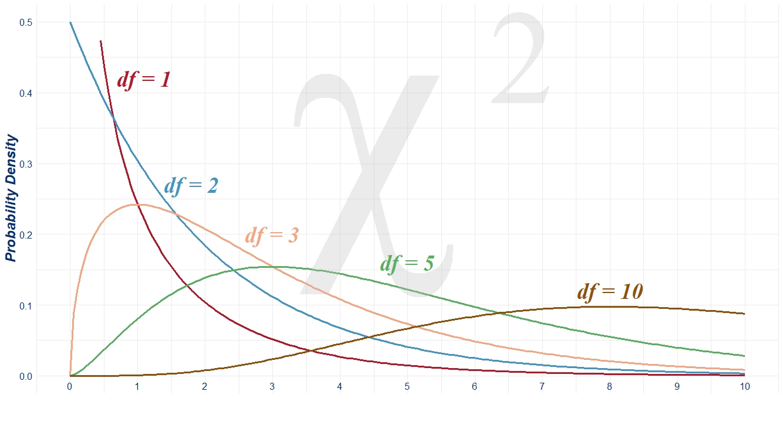

R Shiny App Platform for Education
Loan Robinson
April 5th, 2023

Slide 2
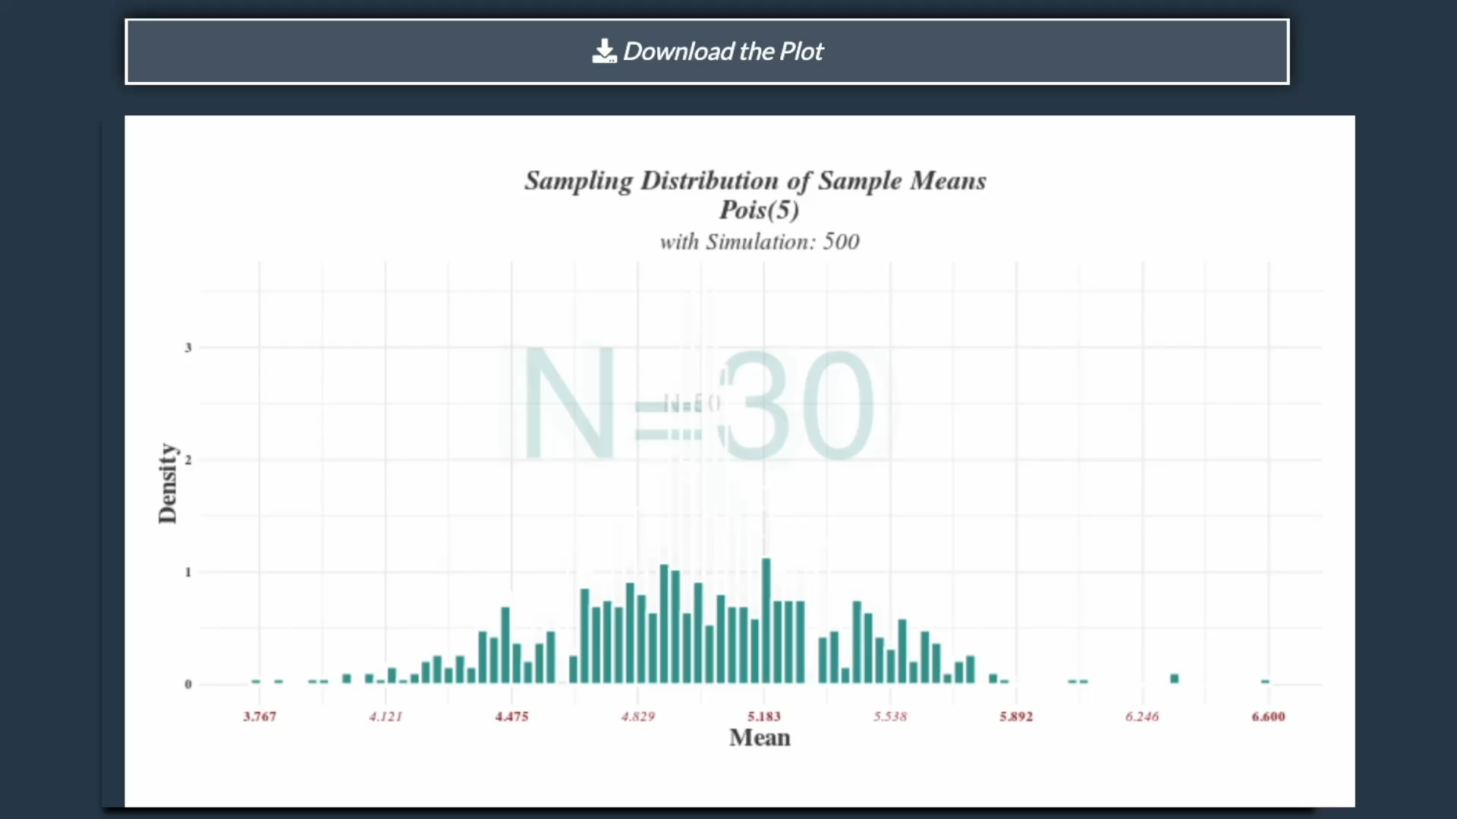
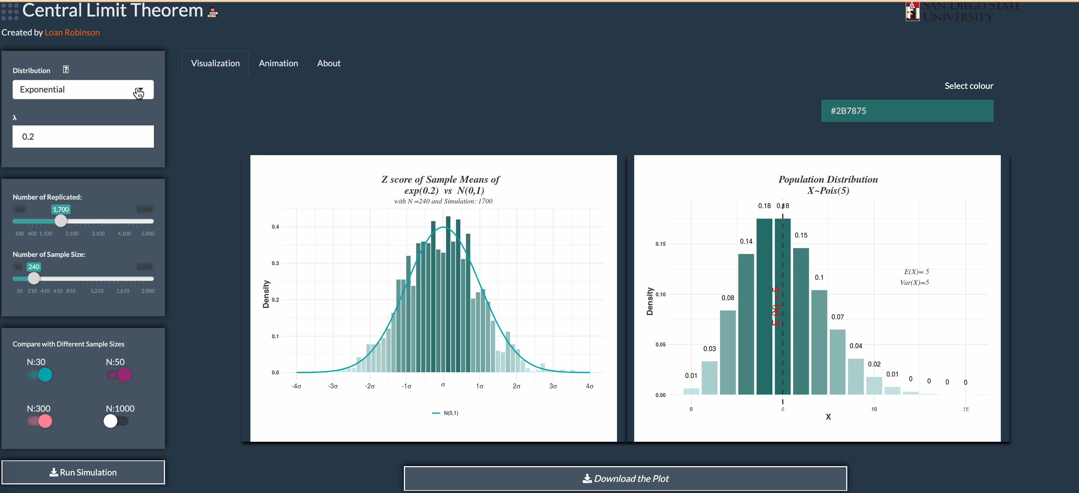
Interactive Visualization for Statistics lessons
Demonstrate the Central Limit Theorem
Visualize the differences between the number of sample sizes

Slide 3
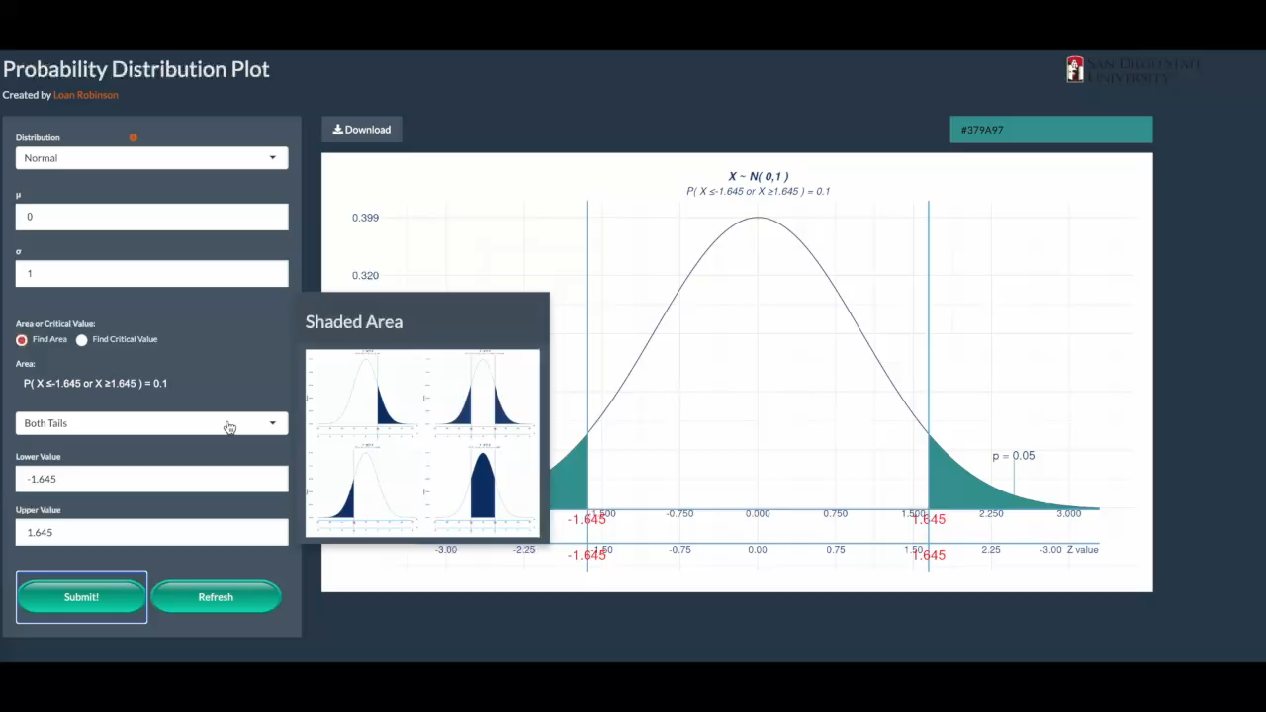
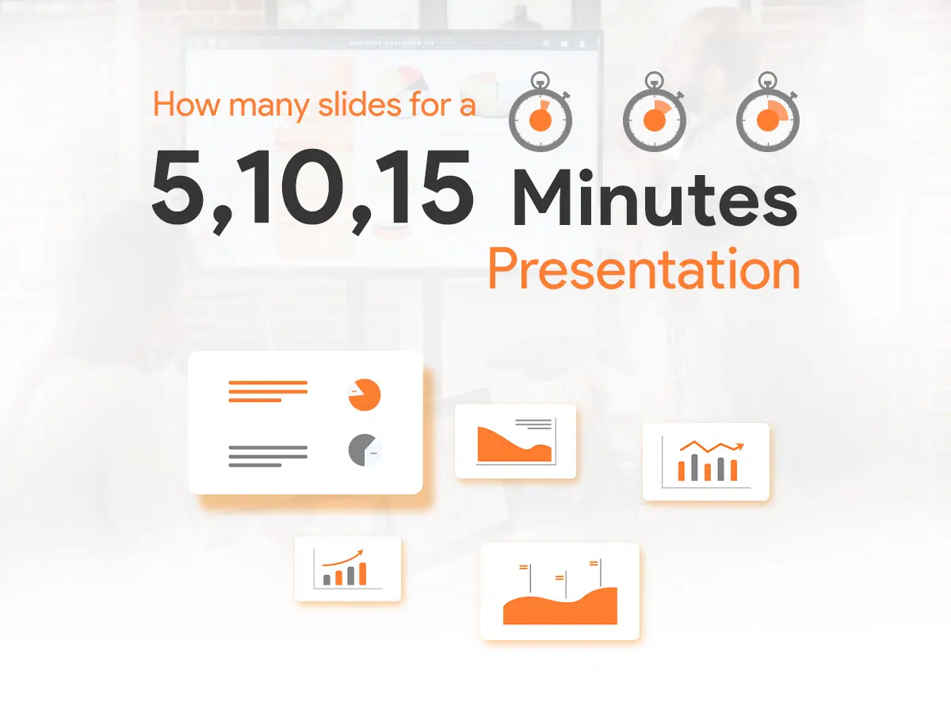
R Shiny App
PowerPoint
Everything in One Screen
Many slides for 1 topic

Slide 4
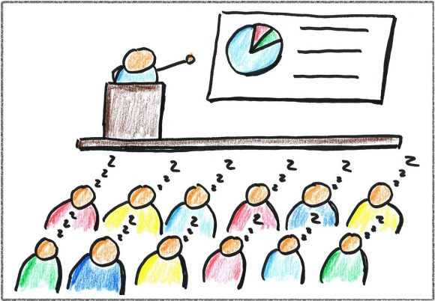

R Shiny App
PowerPoint

Slide 5
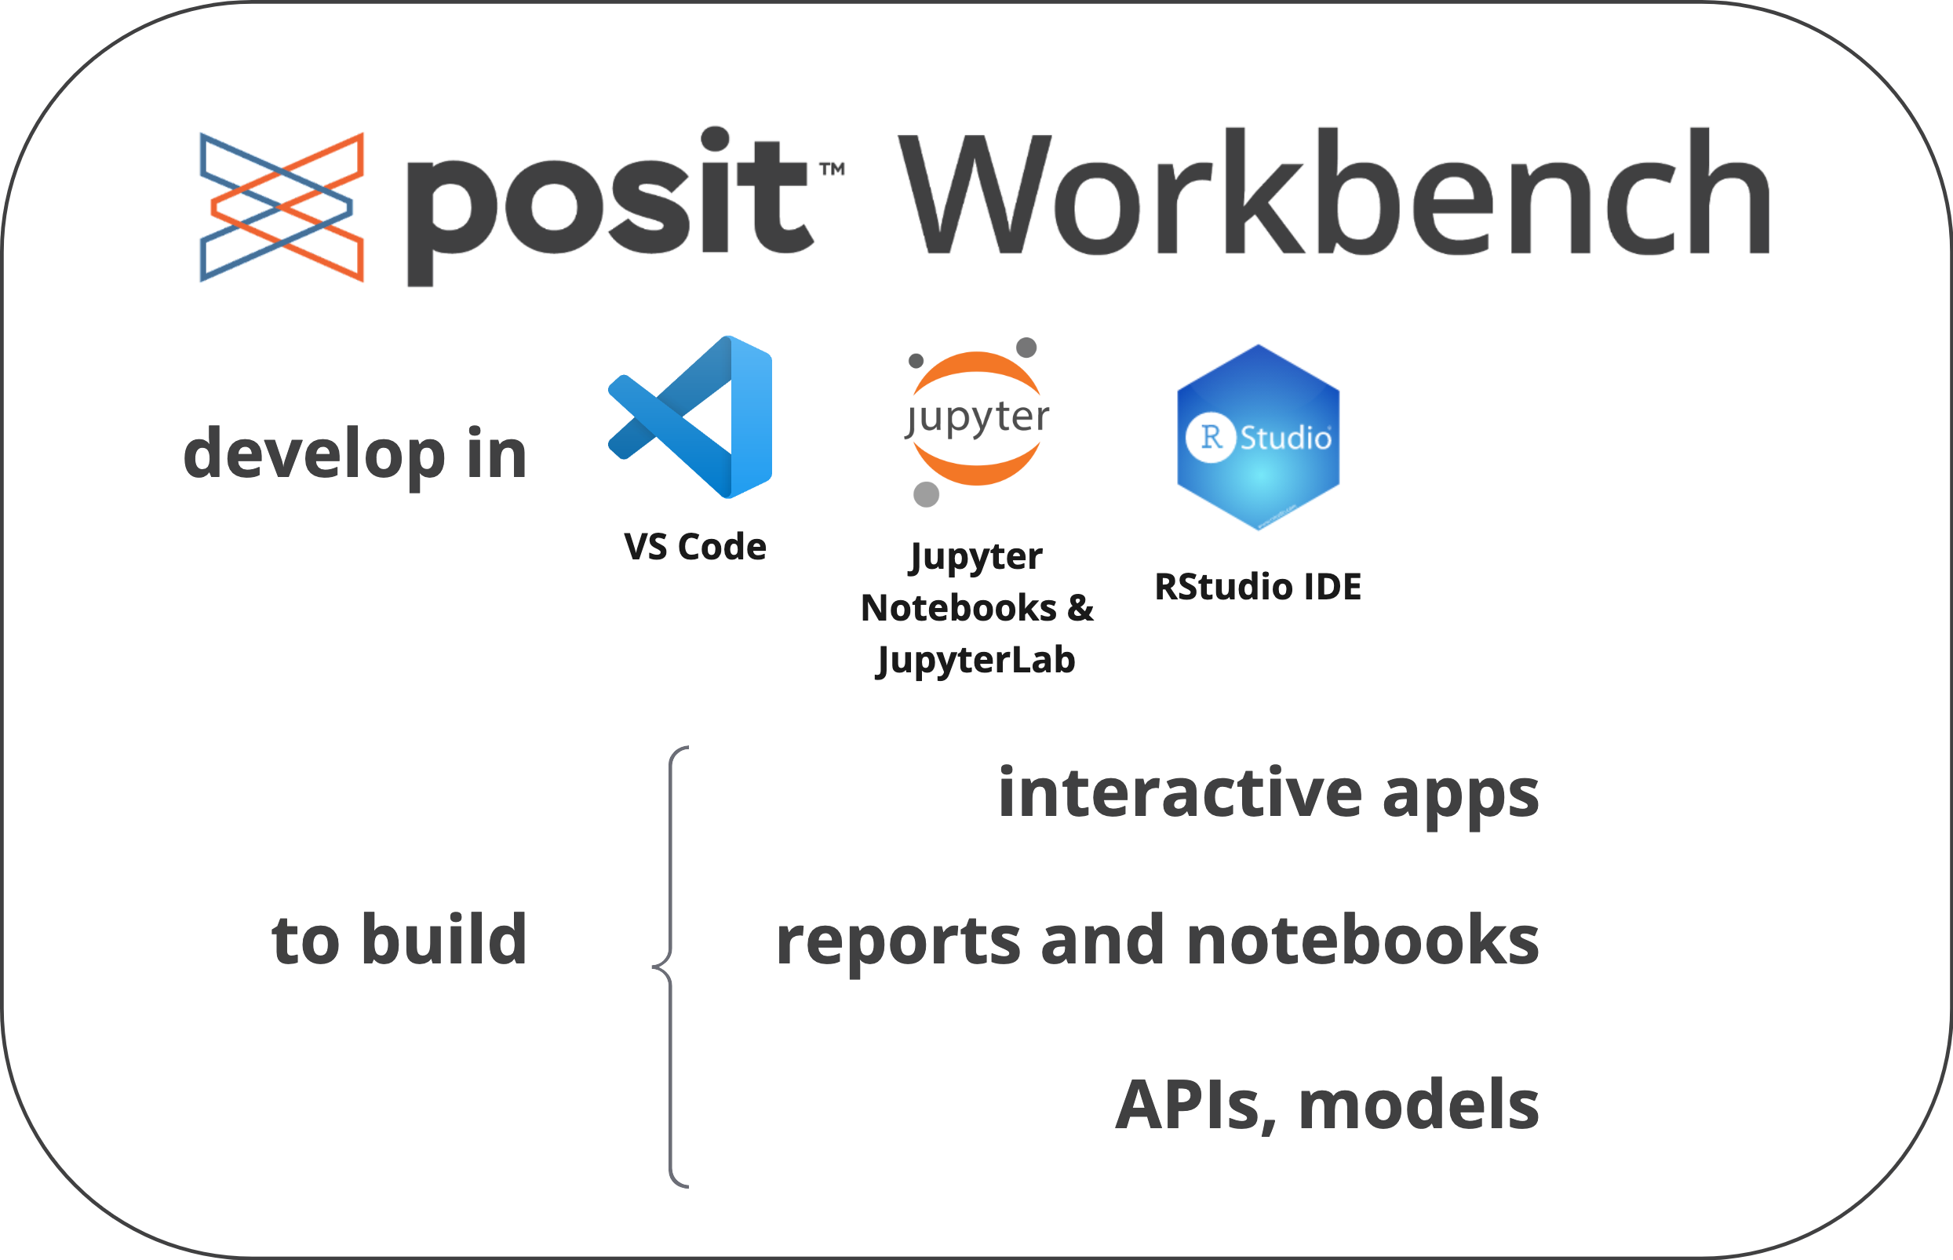
Hand on R and Python in the class

Slide 6


Log In vs Traditional Taking Attendance
Jason, yes
Lauran, yes
Brian, yes
…….
Who misses the lass today?
Great, no need to take attendance

Slide 7

Continue ……… at posit::conf(2023)
September 17th-20th in Chicago

